Slide 1

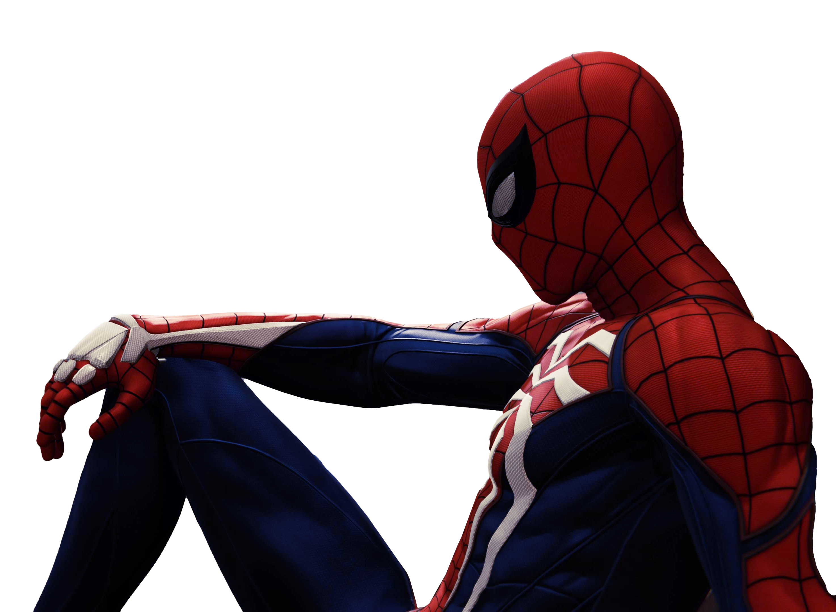

SPIDER- SENSE
SPIDER- SENSE
Because who doesn’t want to be spiderman??

Slide 2

THE PROBLEM

Slide 3
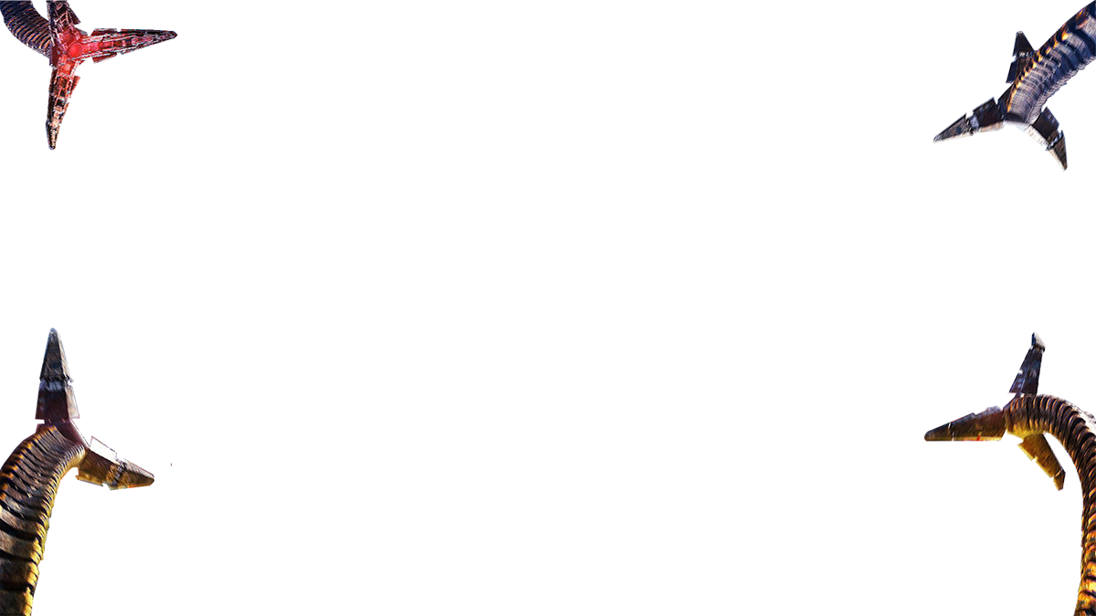
STATISTIC
30
53% of children were killed while walking

Slide 4
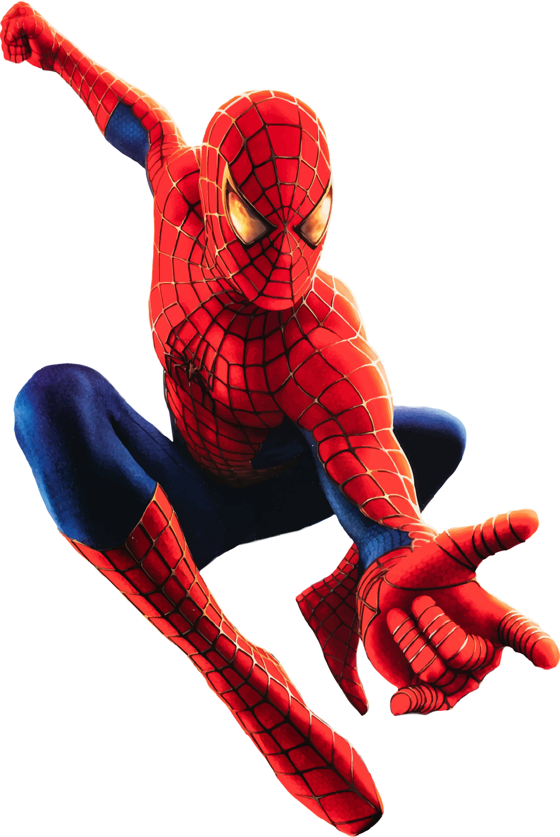
THE PROBLEM

Slide 5

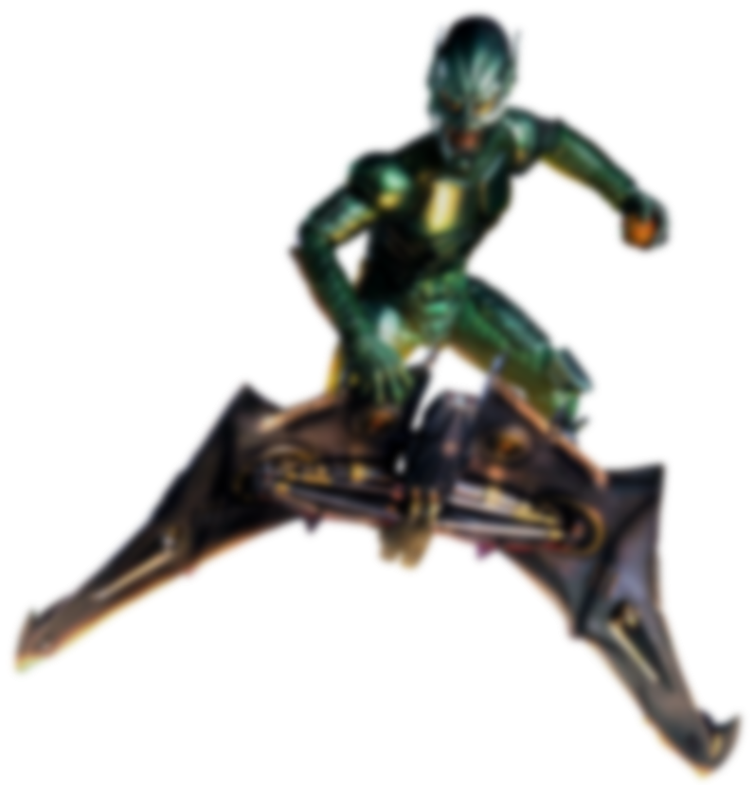

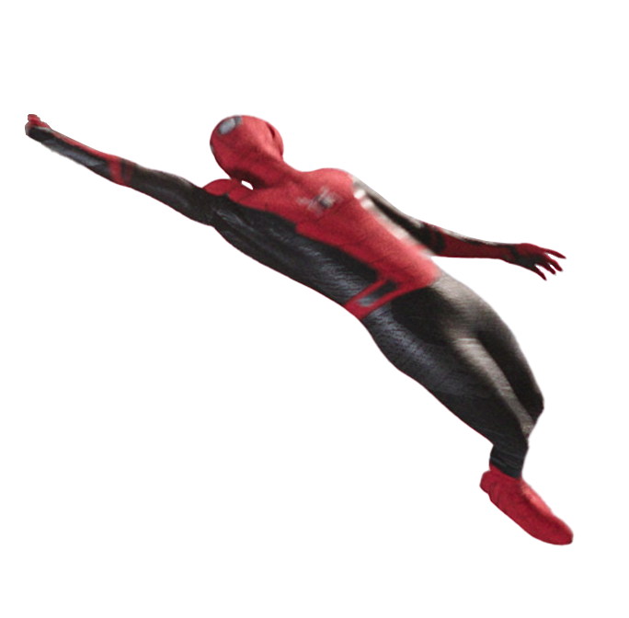

THE SOLUTION
COVER YOUR BLIND SPOTS
BOOST ALERTNESS

Slide 6
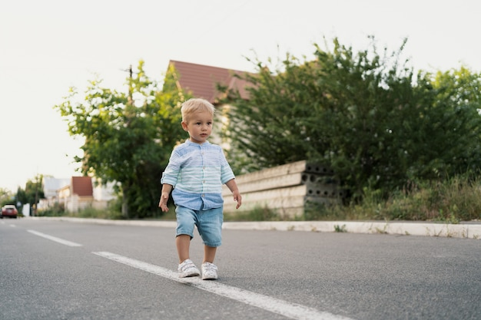
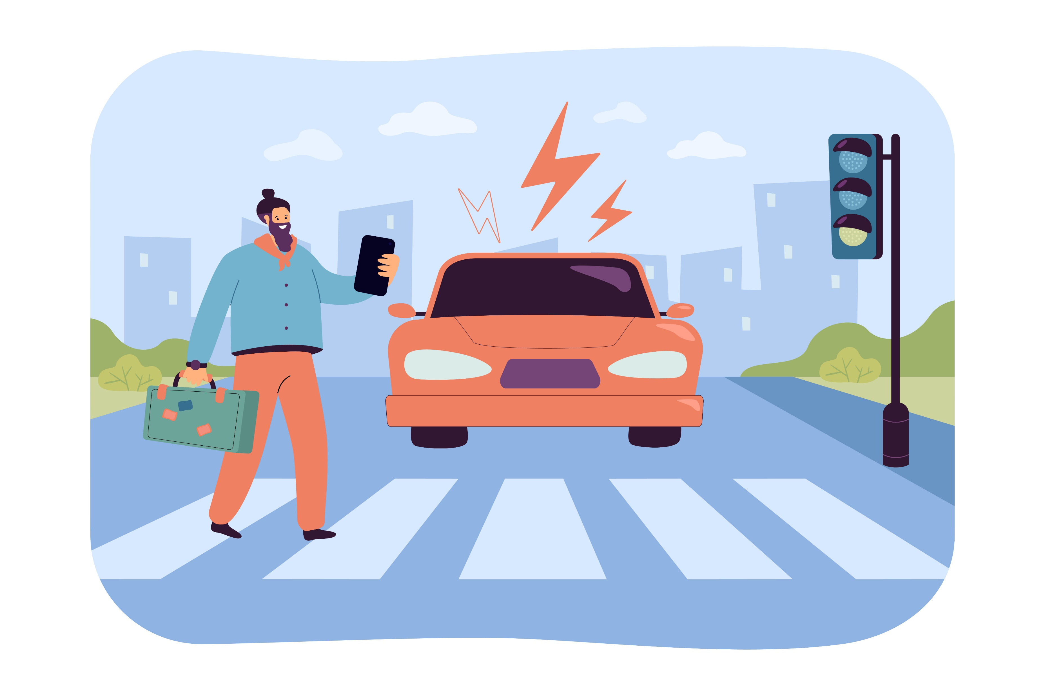


TARGET AUDIENCE

Slide 7
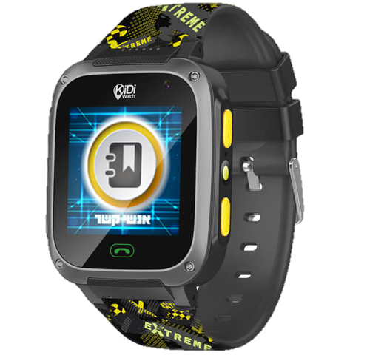
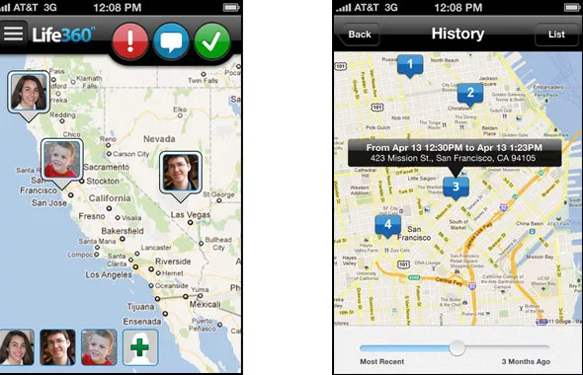
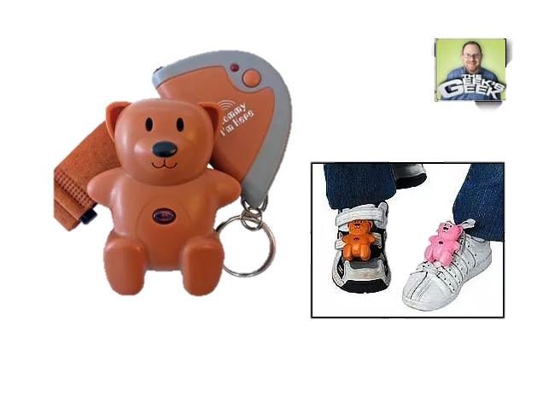
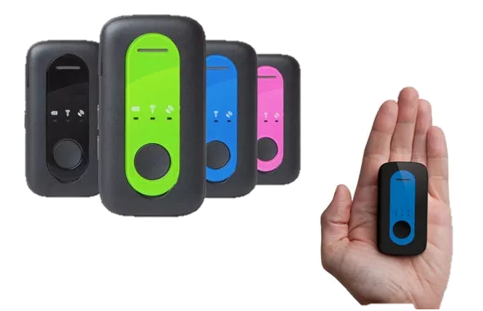
THE MARKET
Kidi watch FIBER
Family locator
Notes:
Kidi watch 130 nis, לחצן מצוקה ואיתור סלולארי

Slide 8
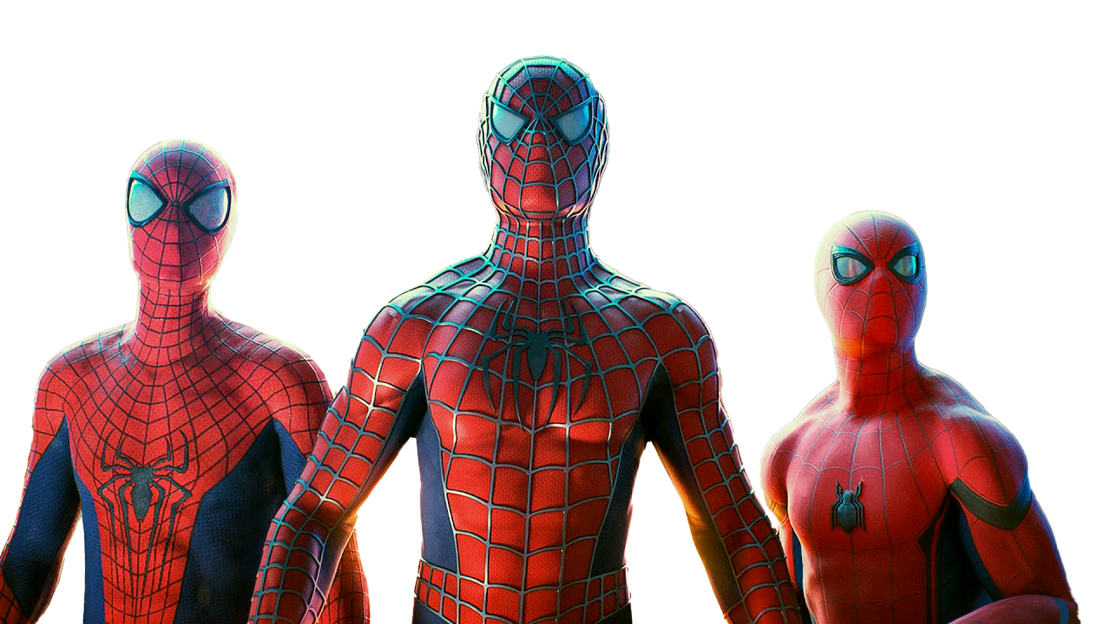
THANK-YOU!
THANK-YOU!
Notes:
Put in here the group

